Slide 1

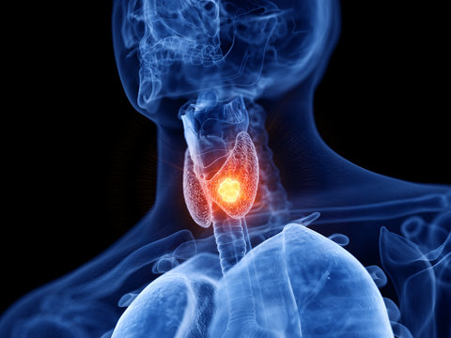
Identification of Hyperthyroidism Using K-Nearest Neighbours
CAPSTONE PROJECT ITA0516 – CV

Slide 2
Team Members
Monish Kumaar M - 192225014
Rudresh - 192225092
Tumu Mani Sai Pavan - 192225011
Guide – Dr.Christy

Slide 3

Project Plan
To Use
Convolutional Neural Network
to identify Hypothyroidism in Goiter from various images.

Slide 4

Requirements
Google Collab
AMD Ryzen 7 4800H processor
16Gb RAM
1 TB SSD storage
NVIDIA RTX 3050 graphics card
Python IDLE 3.12
Dataset – Kaggle.com
Windows 11

Slide 5
Concepts Incorporated
Image preprocessing
Data augmentation
Transfer learning
Object detection

Slide 6
ABSTRACT
Detecting thyroid abnormalities using Convolutional Neural Networks (CNNs) involves leveraging deep learning techniques for image analysis. Key concepts include CNN architecture for feature extraction, image preprocessing, data augmentation to enhance model robustness, transfer learning for leveraging pre-trained models, object detection for localizing thyroid nodules, and evaluation metrics to assess model performance. By integrating these concepts, CNN-based models can effectively identify and classify thyroid abnormalities in medical images, aiding healthcare professionals in diagnosis and treatment planning.

Slide 7
STEPS INVOLVED
Import The Required Libraries
Import The Dataset
Data Preprocessing
Model Building
Data Augmentation
Transfer Learning
Object Detection
Evaluation
Prediction on User Data

Slide 8

DD
MODULES USED
numpy
sklearn
cv2
os
pandas

Slide 9

CORPUS
Corpus is collected from Kaggle.com.
Corpus is named as DDTI: Thyroid Ultrasound.
It is a set of hyperthyroid images.
It contains 99sets of hyperthyroid images, classfied as two parts : Positive & Negative

Slide 10
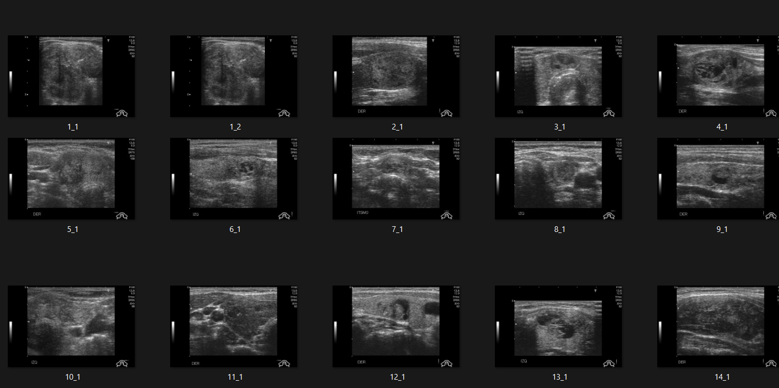
CORPUS

Slide 11

CONCLUSION
Methodology Utilization: Utilizing Convolutional Neural Networks (CNNs), the research aimed to detect thyroid abnormalities in medical images. The approach encompassed preprocessing data, designing CNN architectures, training models, and evaluating performance.
Evaluation of Techniques: Effectiveness of CNNs was gauged using metrics like accuracy, precision, recall, and F1-score. Various CNN architectures and hyperparameters were tested, comparing results against traditional machine learning methods to establish benchmarks.
Effectiveness of CNN: CNNs proved highly effective in detecting thyroid abnormalities, outperforming conventional techniques by directly learning features from images. Integration of transfer learning with pre-trained models further enhanced accuracy, especially with limited training data.
Challenges and Limitations: Challenges included dataset imbalance, model interpretability, and computational demands. CNNs may struggle with rare or subtle abnormalities, necessitating refinement and validation.
Recommendations for Future Research: Research avenues include dataset augmentation to address imbalance, interpretability methods for transparency, and optimization strategies for efficiency. Exploring advanced CNN architectures and multi-modal data integration could advance diagnostic capabilities and clinical outcomes.

